Slide 1
HTML5 – Mid and Advanced
Object Oriented JavaScript
18th of September, 2013

Slide 2
"Just because JavaScript is classless, doesn't mean you have to be.“
-- Nicholas Zakas

Slide 3
Is JavaScript an OOP language?
JavaScript is a functional, dynamic and interpreted language. OOP can be achieved in two ways(…ouch!)
Key features of OOP:
  Polymorphism
  Encapsulation (one way to support is through Closure)
  Inheritance (one way to support is through Prototypal Inheritance)
  The main difference between classical OOP languages (C++, Java, .NET) and JavaScript is that the OOP features are not provided out-of-the-box by the language.

Slide 4
Value types (primitives) vs. reference types
Type | Example | Value (V) / Reference (R)
Undefined | undefined | V
Null | null | V
Boolean | true | V
String | “example” / ‘example’ | V
Number (double) | 3.14159 | V
Object | { foo: ‘bar’ } | R
Function | function f() { … } | R
Array | [ ‘one’, 2, true ] | R
RegExp | /ab+c/i | R
Date | Wed Sep 18 2013 10:00:00 GMT+0300 | R
Number (primitive wrapper object) | new Number(3.14159) | R
Boolean (primitive wrapper object) | new Boolean(true) | R
String (primitive wrapper object) | new String(‘example’) | R
Notes:
Althought Value types are not objects, constructions like “a string”.length are valid because JS instantiates a wrapper object temporarily and that object has useful properties and methods like: length, replace(), split(), trim() etc. -> http://www.w3schools.com/jsref/jsref_obj_string.asp
More details on Primitives here: http://javascriptweblog.wordpress.com/2010/09/27/the-secret-life-of-javascript-primitives/

Slide 5

Value types (primitives) vs. reference types
1 - ValueTypes-ReferenceTypes.html

Slide 6



Undefined and delete
Initial state for the myObject2 object: 2 properties myString and myNumber
var myObject1 = {};
var myObject2 = {
myString: "a string",
myNumber: 3.14159
};
delete myObject2.myNumber;
After the delete instruction, myObject.myNumber becomes “undefined”

Slide 7

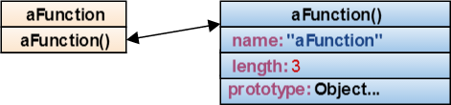
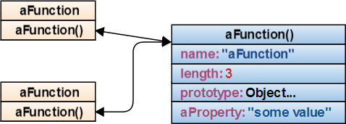

Functions
Functions are regular types of objects.
Functions are objects with a default 3 properties: name, length (number of arguments) and prototype
function aFunction (param1, param2, param3) {
return true;
}
aFunction.aProperty = "some value";
var anotherFunction = aFunction;
anotherFunction(); // returns true

Slide 8
Functions
2 - Functions.html
Notes:
Exercises:
1.
function test(o) {
o = null;
}
var x = [];
test(x);
alert(x);
Q:What is x? [], null, undefined, throw
---
A: [], because o only knows the value that was passed to it (in this case an empty array); it does not change the array, it only changes what o is pointing to
2.
function swap(a,b) {
var temp = a;
a = b;
b = temp;
}
var x = 1, y = 2;
swap(x, y);
alert(x);
Q: What is x? 1, 2, undefined, throw
---
A: 1, because the function doesn't sees the variables, but only the values of the variables
3.
Write a function that takes an argument an returns that argument
---
function identity(x) {
return x;
}
4.
Write two functions add and mul, that take two numbers and return their sum and product
---
function sum(a, b) {
return a+b;
}
function mul(a, b) {
return a*b;
}
5.
Write a function that takes an argument and returns a function that returns that argument
---
function arg(x) {
return function() {
return x;
};
}
6.
Write a function that adds from two invocations (add(1)(2))
---
function add(a) {
return function(b) {
return a + b;
}
}
7.
Write a function named applyf that takes a binary function, and makes it callable with two invocations (addf = applyf(add); addf(3)(4)//7; applyf(mul)(3)(4)//12;)
---
function add(a) {
return function(b) {
return a + b;
}
}
function applyf(f) {
return function(a) {
return function(b) {
return f(a, b);
}
}
}
8.
Write a function that takes a function and an argument, and returns a function that can supply a second argument (add3 = curry(add, 3); add3(4); curry(mul, 5)(6))
---
function curry(func, a) {
return function(b) {
return func(a,b);
}
}
9.
Without writing any new functions (only using functions already written), show three ways to create the inc function (inc(5)//6; inc(inc(5))//7)
---
inc = add(1);
inc = applyf(add)(1);
inc = curry(add, 1);
10.
Write methodize, a function that converts a binary function to a method (Number.prototype.add = methodize(add); (3).add(4))
---
function methodize(func) {
return function(a) {
return func(this, a);
}
}
11.
Write a function twice that takes a binary function and returns an unary function that passes its arguments to the binary function twice (var double = twice(add); twice(11) //22; var square = twice(mul); square(11) //121;)
---
function twice(binary) {
return function(a) {
return binary(a, a);
}
}
12.
Write a function compose that takes two unary functions and returns an unary function that calls them both (compose(double, square)(3) //36)
---
function compose(f1, f2) {
return function(a) {
return f2(f1(a));
}
}
13.
Write a function compose that takes two binary functions and returns a function that calls them both (compose(add, mul)(2, 3, 5) //25)
---
function compose(f1, f2) {
return function(a, b, c) {
return f2(f1(a, b), c);
}
}
14.
Write a function that allows another function to only be called once (add_once = once(add); add_once(3, 4) //7; add_once(3, 4) //throw;)
---
function once(f) {
return function() {
var f_temp = f;
f = null;
return f_temp.apply(this, arguments);
};
}
15.
Make a revocable function that takes a F function, and returns a revoke function that denies the access to the F function, and an invoke function that can invoke the F function until it is revoked (temp = revocable(alert); temp.invoke(7) //alert: 7; temp.revoke(); temp.invoke(8) //throw!)
---
function revocable(F) {
return {
invoke: function () {
return F.apply(this, arguments);
},
revoke: function () {
F = null;
}
}
}

Slide 9

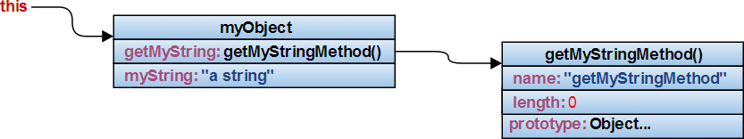

Methods
Functions defined inside an object are called methods
var myObject = {
getMyString: function getMyStringMethod () {
return this.myString;
},
myString: "a string"
}
myObject.getMyString(); // returns "a string"
"this" is always assigned to the object that you use. When function returns, "this" is set to whatever value it was before.
E.g.: when calling myObject.getMyString(), "this" is set to "myObject"

Slide 10
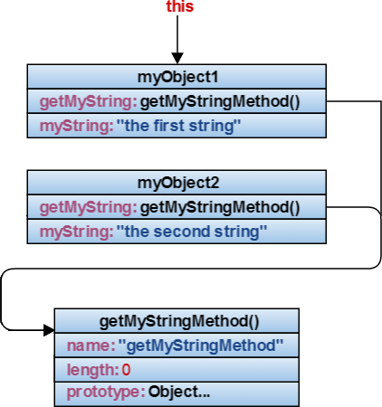

Methods
“this” depends on the object, not on the function it was defined. Use “call”, “apply” or “bind” to change the context
function getMyStringMethod() {
return this.myString;
}
var myObject1 = {
getMyString: getMyStringMethod,
myString: "the first string"
};
var myObject2 = {
getMyString: getMyStringMethod,
myString: "the second string"
};
myObject1.getMyString(); // returns "the first string"
myObject2.getMyString(); //returns "the second string"
getMyStringMethod(); // return ...
getMyStringMethod.call(myObject1); // returns ...
Notes:
- getMyStringMethod(); // return value can be undefined or global object
- getMyStringMethod.call(myObject1); // returns “the first string”

Slide 11
Methods
3 - Methods.html

Slide 12
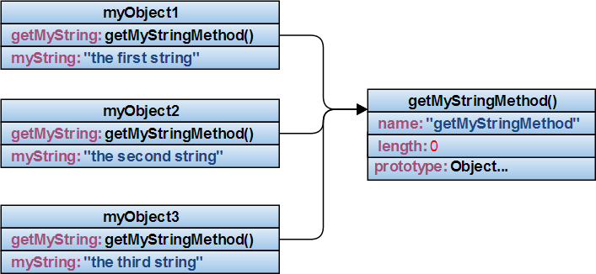
Prototypal inheritance
Fundamentals of Inheritance: define “getMyStringMethod” method in one place, in order to maintain more easily the code

Slide 13
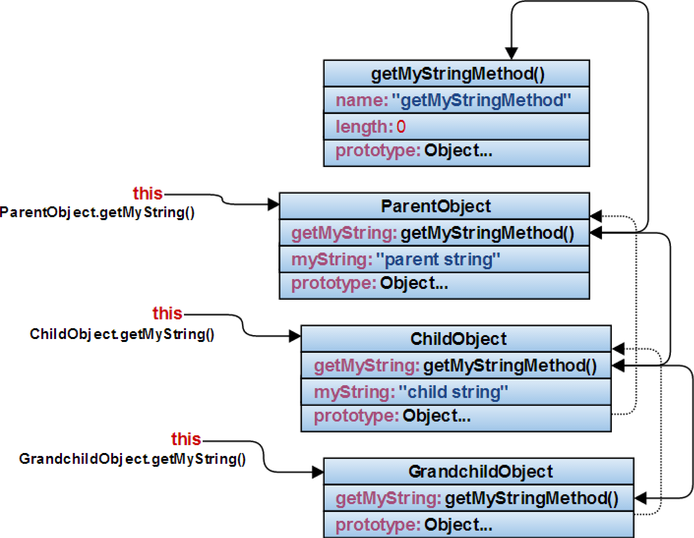
Prototypal inheritance
When calling a function or accessing a property,
JavaScript looks upper into the hierarchy chain until is found.

Slide 14

Prototypal inheritance
var ParentObject = {
getMyString: function getMyStringMethod() {
return this.myString;
},
myString: "parent string"
};
var ChildObject = Object.create(ParentObject);
ChildObject.myString = "child string";
var GrandchildObject = Object.create(ChildObject);
ParentObject.getMyString(); // returns ...
ChildObject.getMyString(); // returns ...
GrandchildObject.getMyString(); // returns ...
- When calling ParentObject.getMyString(), “this” is set to …, and returns …
- When calling ChildObject.getMyString(), “this” is set to …, and returns …
- When calling GrandchildObject.getMyString(), “this” is set to …, and returns …
Notes:
- ParentObject.getMyString(); // returns “parent string”; “this” is set to ParentObject
- ChildObject.getMyString(); // returns “child string”; “this” is set to ChildObject, looks into the prototype, finds getMyString and returns this.myString since “this” was set to ChildObject
- GrandchildObject.getMyString(); // returns “child string”; “this” is set to GrandchildObject

Slide 15
Prototypal inheritance
4 - Prototypal Inheritance.html

Slide 16
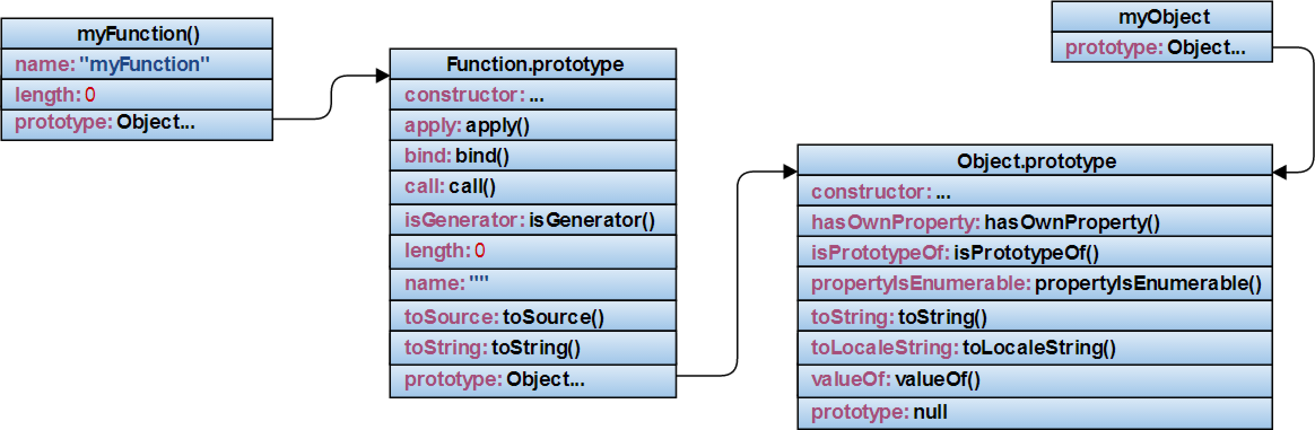
Prototype
Objects have Object.Prototype as their prototype
Functions have Function.Prototype as their prototype
var myObject = {};
function myFunction() {};
Notes:
https://developer.mozilla.org/en-US/docs/Web/JavaScript/Reference/Global_Objects/Object/prototype
https://developer.mozilla.org/en-US/docs/Web/JavaScript/Reference/Global_Objects/Function

Slide 17
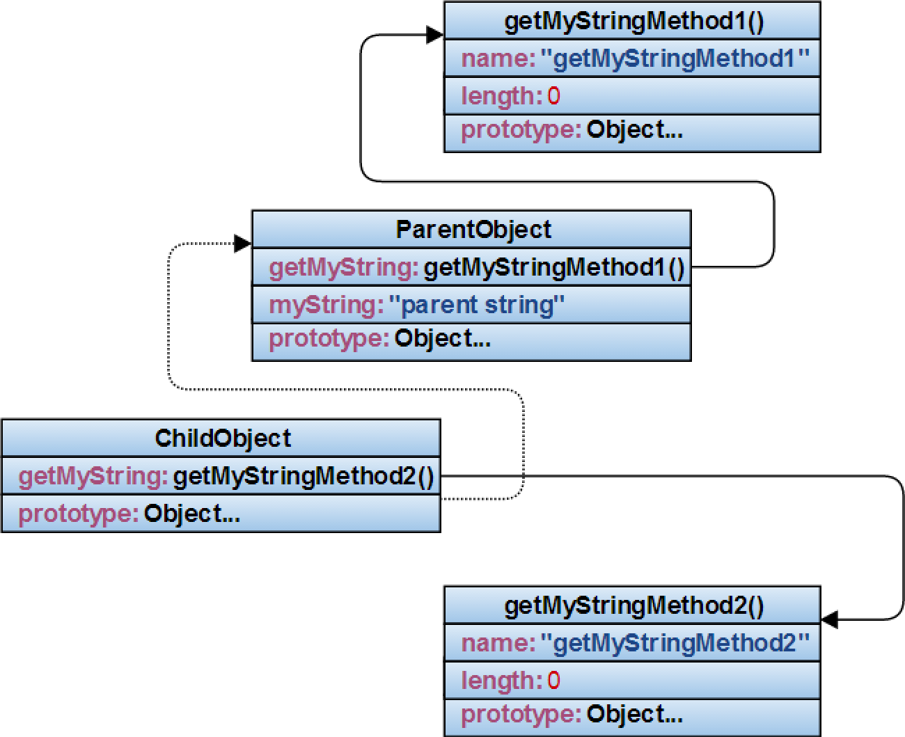
Polymorphism
Polymorphism: the capability of an object to act as if it was another object in its hierarchy chain.
Anti-pattern: difficult to maintain.
(duplicate code)

Slide 18
Polymorphism
5 - Polymorphism - Anti-pattern.html

Slide 19
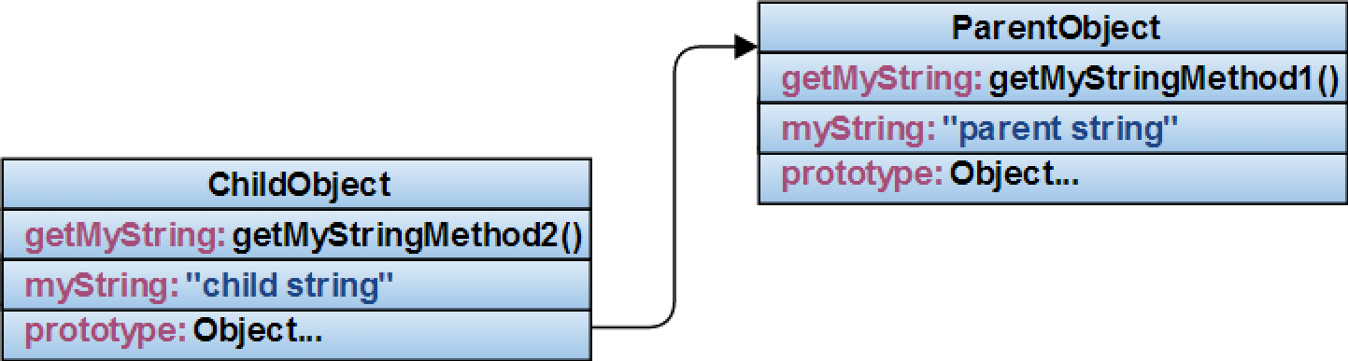
Method overriding and context (this)
A more closer approach to OOP is to call getMyStringMethod1() from getMyStringMethod2()

Slide 20

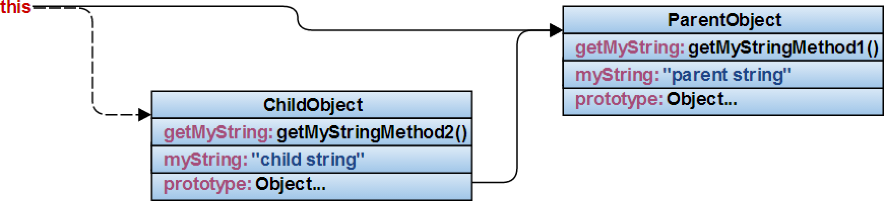
Method overriding and context (this)
Misusage
ChildObject.getMyString = function getMyStringMethod2() {
return ParentObject.getMyString() + " modified";
};
ChildObject.myString = “child string";
Notes:
- ParentObject.getMyString(); // returns “parent string”; “this” is set to ParentObject
- ChildObject.getMyString(); // returns “parent string modified”; “this” is set to ParentObject, once the getMyStringMethod1() is called

Slide 21
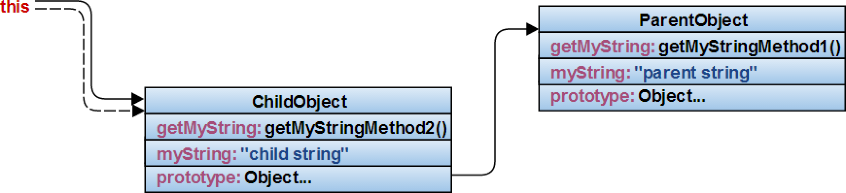
Method overriding and context (this)
ChildObject.getMyString = function getMyStringMethod2() {
return ParentObject.getMyString.call(this) + " modified";
};
ChildObject.myString = “child string";
Notes:
- ParentObject.getMyString(); // returns “parent string”; “this” is set to ParentObject
- ChildObject.getMyString(); // returns “child string modified”; “this” is set to ChildObject because getMyStringMethod1() is called in the context of ChildObject

Slide 22
Method overriding and context (this)
6 - Method overriding and context.html

Slide 23

Scope in JavaScript
JavaScript does not have block scope
var i = 0;
for (i = 0; i <= 5; i++) {
var innerVar = i;
}
console.log(innerVar); // outputs 5
The only scope provided by JavaScript is function scope: the variables defined inside a function are only visible inside that function

Slide 24

Scope in JavaScript - Closure
the context of an inner function includes the scope of the outer function
an inner function enjoys that context, even after the parent function have returned
var digit_name = (function () {
var names = ['zero', 'one', 'two', 'three'];
return function (n) {
return names[n];
}
}());
console.log(digit_name(3)); //three

Slide 25
Scope in JavaScript
7 - Scope in JavaScript.html

Slide 26
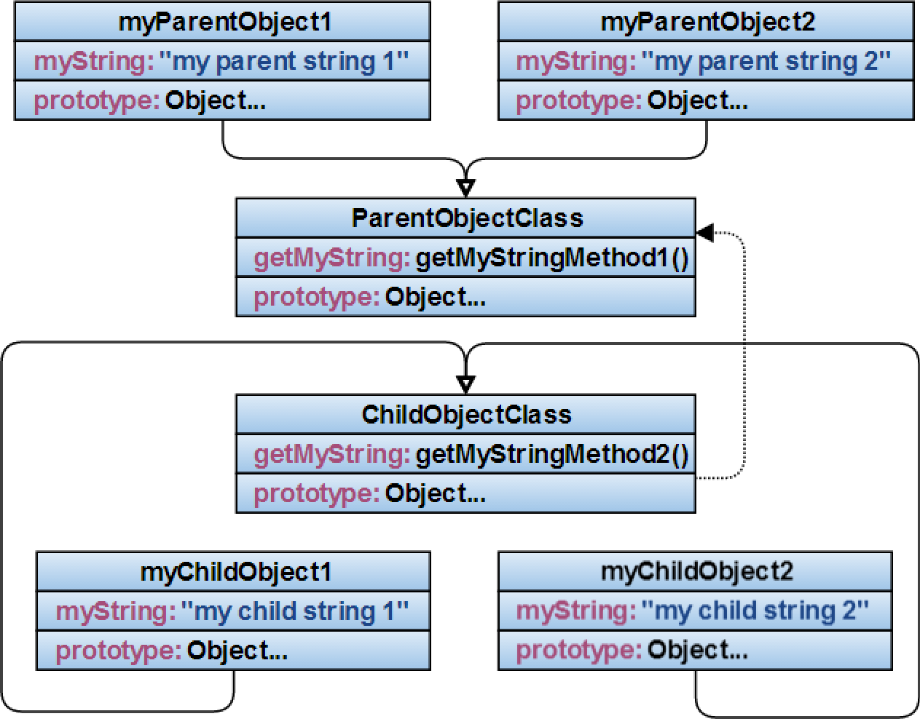


Classes and instantiation
Classes contains structure and Instances contains data.
Instance
Class

Slide 27


Classes and instantiation
Bad design (duplicate code, no encapsulation)
var ParentObjectClass = {
getMyString: function getMyStringMethod1() {
return this.myString;
}
};
var myParentObject1 = Object.create(ParentObjectClass);
myParentObject1.myString = "my parent string 1";
var myParentObject2 = Object.create(ParentObjectClass);
myParentObject2.myString = "my parent string 2";
Notes:
- myParentObject1.getMyString()// returns “my parent string 1”; “this” is set to myParentObject1
- myParentObject2.getMyString()// returns “my parent string 2”; “this” is set to myParentObject2

Slide 28

Classes and instantiation
Constructor, encapsulation, code reuse
var ParentObjectClass = {
constructor: function c(options) {
this._val = options.value;
//this._val = arguments[0].value;
},
getMyString: function getMyStringMethod1() {
return this._val;
}
};
var myParentObject1 = Object.create(ParentObjectClass);
myParentObject1.constructor({value: "my parent string 1"});
var myParentObject2 = Object.create(ParentObjectClass);
myParentObject2.constructor({value: "my parent string 2"});
Prototypal inheritance implies: defining Classes (Prototypes), creating
objects (Object.create()) and calling Constructors.

Slide 29
Classes and instantiation
8 - Classes and Instantiation.html
&
9 - Classes and Instantiation2.html

Slide 30

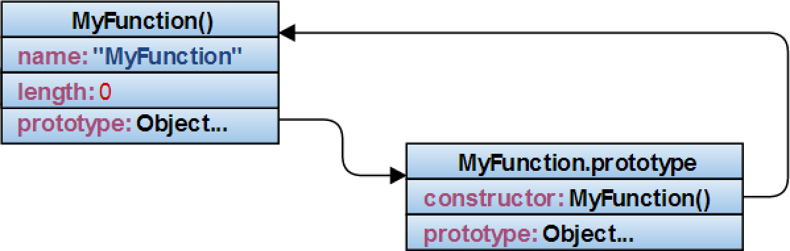

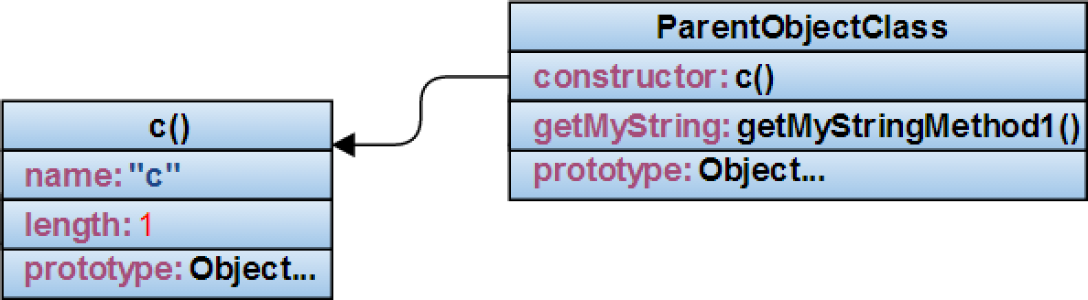
Classical Inheritance
The prototype of a new declared function points to an object that has a constructor function that points back to the newly created function (circular reference)
function MyFunction () {};
var ParentObjectClass = {
constructor: function c(options) {
this._val = options.value;
},
getMyString: function getMyStringMethod1() {
return this._val;
}
};
Notes:
As a convention in JS, constructors should start with a capital letter

Slide 31

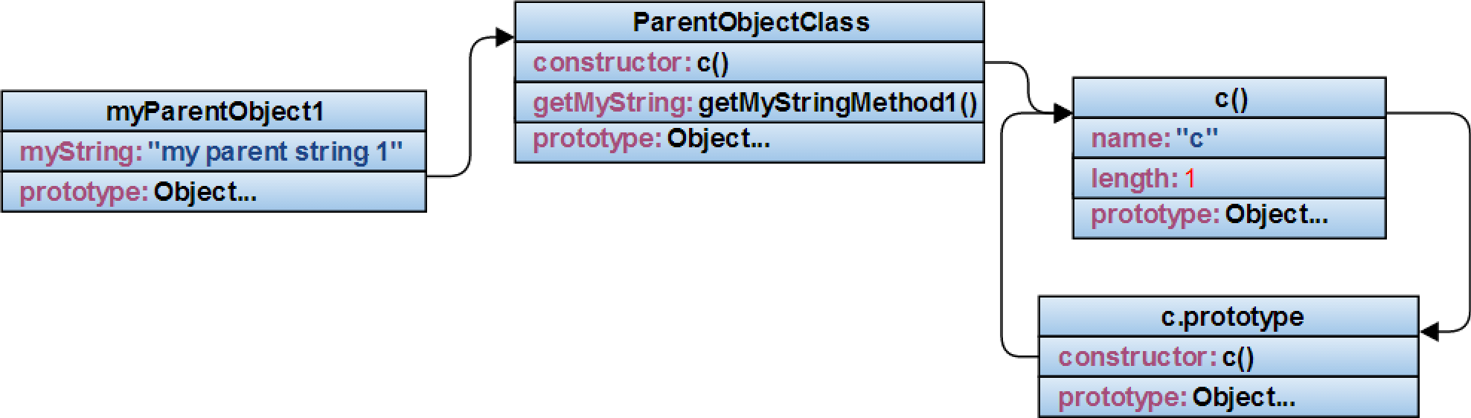
Classical & Prototypal Inheritance
var ParentObjectClass = {
constructor: function c(options) {
this._val = options.value;
//this._val = arguments[0].value;
},
getMyString: function getMyStringMethod1() {
return this._val;
}
};
var myParentObject1 = Object.create(ParentObjectClass);
myParentObject1.constructor({value: "my parent string 1"});

Slide 32

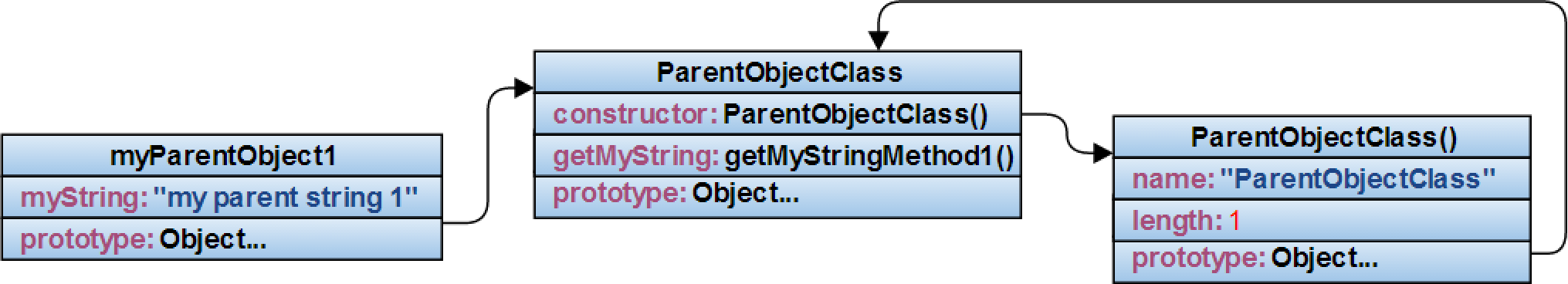
Classical & Prototypal Inheritance
function ParentObjectClass(options) {
this._val = options.value;
//this._val = arguments[0].value;
}
ParentObjectClass.prototype.getMyString = function getMyStringMethod1() {
return this._val;
}
var myParentObject1 = new ParentObjectClass({value: "my parent string 1“});
Notes:
The “new” keyword does the following:
- creates a child (myParentObject1) of the ParentObjectClass class
- initializes the child (myParentObject1), by calling the constructor from it’s parent (ParentObjectClass)
- assigns the prototype of the constructor to the ParentObjectClass class

Slide 33
Classical & Prototypal Inheritance
10 - Prototype Based vs Classical Inheritance.html

Slide 34

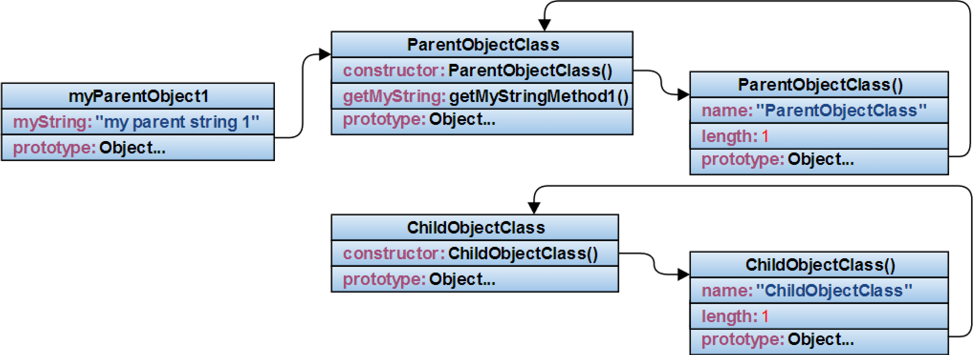
Subclassing
function ParentObjectClass(options) {
this._val = options.value;
//this._val = arguments[0].value;
}
ParentObjectClass.prototype.getMyString = function getMyStringMethod1() {
return this._val;
}
var myParentObject1 = new ParentObjectClass({value: "my parent string 1"});
function ChildObjectClass(options) {
ParentObjectClass.call(this, options);
}

Slide 35
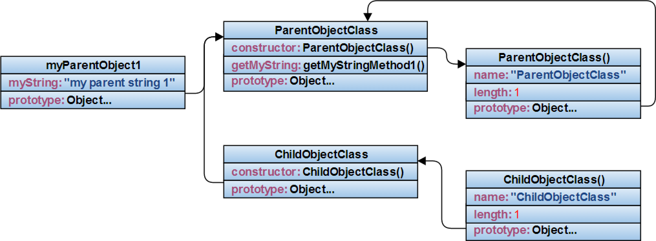
Subclassing
…
ChildObjectClass.prototype = Object.create(ParentObjectClass);

Slide 36

Subclassing
…
ChildObjectClass.prototype.constructor = ChildObjectClass;

Slide 37
Subclassing
11 - Subclassing.html

Slide 38


typeof and instanceof
typeof is an unary operator, which returns a string representing the type of its operand
typeof 1; // returns "number"
typeof "a string“; // returns "string"
typeof ‘a string’; // returns "string"
typeof {}; // returns "object"
typeof []; // returns "object"
typeof function () {}; // returns "function"
instanceof is a binary operator which inspects first operand’s prototype chain for the presence of the prototype property of the second operand (the second operand is expected to be a constructor)
myChildObject1 instanceof ChildObjectClass; // true
myChildObject1 instanceof ParentObjectClass; // false
myChildObject1 instanceof Object; // true
new Date instanceof Date; //true
[1, 2, 3] instanceof Array; //true
Notes:
“Working with JavaScript’s typeof operator is a bit like operating a clapped-out old car (or an early model Dell Inspiron)” -> http://javascriptweblog.wordpress.com/2011/08/08/fixing-the-javascript-typeof-operator/
“instanceof is considered harmful” -> http://perfectionkills.com/instanceof-considered-harmful-or-how-to-write-a-robust-isarray/

Slide 39
typeof and instanceof flaws
typeof
typeof null is “object”
typeof NaN is “number”
typeof does not distinguish between generic objects and the other built-in types (Array, Arguments, Date, JSON, RegExp, Math, Error, and the primitive wrapper objects Number, Boolean and String)
instanceof
built-in objects like Math, JSON and arguments do not have associated constructor objects – so they cannot be type-checked with the instanceof operator
a window can comprise multiple frames, which means multiple global contexts and therefore multiple constructors for each type (a given object type is not guaranteed to be an instanceof of a given constructor)
host objects are browser-created objects that are not specified by the ES5 standard (window, document, document.createElement(‘a’), alert etc.)
Notes:
typeof does not distinguish between generic objects and other built-in types (if typeof is applied to any object type other than Function, it returns “object”):
- typeof [“one”, 2, true] is “object”
- typeof (new Date()) is “object”
- typeof (new Number(3.14159)) is “object”
instanceof flaws examples:
a) Math instanceof Math is “TypeError”
b) var iFrame = document.createElement('IFRAME');
document.body.appendChild(iFrame);
var IFrameArray = window.frames[1].Array;
var array = new IFrameArray();
array instanceof Array; //false
array instanceof IFrameArray; //true;
c) toType(window); //“global” (Chrome), “domwindow” (Safari), “window” (FF/IE9), “object” (IE7/IE8)
toType(document); //“htmldocument” (Chrome/FF/Safari), “document” (IE9), “object” (IE7/IE8)
toType(document.createElement('a')); //“htmlanchorelement” (Chrome/FF/Safari/IE), “object” (IE7/IE8)
toType(alert); //“function” (Chrome/FF/Safari/IE9), “object” (IE7/IE8)

Slide 40

typeof and instanceof fixes
Every JavaScript object has an internal property known as [[Class]] (unique, non-editable, standards-enforced), which is “a String value indicating a specification defined classification of objects”. Object.prototype.toString() returns "[object ", class, and"]"
Object.toType = (function toType(global) {
return function(obj) {
if (obj === global) {
return "global";
}
return ({}).toString.call(obj).match(/\s([a-z|A-Z]+)/)[1].toLowerCase();
}
})(this);
Notes:
Object.prototype.toString():
- Object.prototype.toString.call([“one”, 2, true]); //“[object Array]” vs. [“one”, 2, true].toString(); //“one, 2, true”
- Object.prototype.toString.call(new Date()); //“[object Date]” vs. (new Date).toString(); //“Wed Aug 18 2013 10:00:00 GMT-0700 (PDT)”
- Object.prototype.toString.call(/a-z/); //“[object RegExp]” vs. (/a-z/).toString(); //“/a-z”
toType():
- Object.toType([“one”, 2, true]); //“array”
- Object.toType(new Date()); //“date”
- Object.toType (new Number(3.14159)) ; //“number”

Slide 41
typeof and instanceof fixes
12 - Typeof and Instanceof.html

Slide 42
prototype, __proto__, getPrototypeOf()
the __proto__ property is an internal property available in all instances constructed by a constructor function (e.g. myParentObject1.__proto__)
__proto__ is a non-standard, deprecated property and should NOT be used; use getPrototypeOf() instead (e.g. Object.getPrototypeOf(myParentObject1))
__proto__ points to the prototype property of the constructor of the instance

Slide 43

prototype, __proto__, getPrototypeOf()
main differences between prototype and __proto__ properties:
- __proto__ is a property of the instances, whereas prototype is a property of their constructor functions
- __proto__ property is the actual object that is used in the lookup chain to resolve methods, whereas prototype property is the prototype of objects constructed by their functions
function ParentObjectClass(options) {
this._val = options.value;
//this._val = arguments[0].value;
}
ParentObjectClass.prototype.getMyString = function getMyStringMethod1() {
return this._val;
}
var myParentObject1 = new ParentObjectClass({value: "my parent string 1"});
Notes:
Correspondents for:
- myParentObject1.__proto__
- Object.getPrototypeOf(myParentObject1)
- myParentObject1.costructor.prototype
- myParentObject1.prototype
- myParentObject1.__proto__.__proto__
- ParentObjectClass.__proto__
- ParentObjectClass.prototype
- ParentObjectClass.prototype.prototype
- ParentObjectClass.prototype.__proto__
- Object.prototype.__proto__

Slide 44
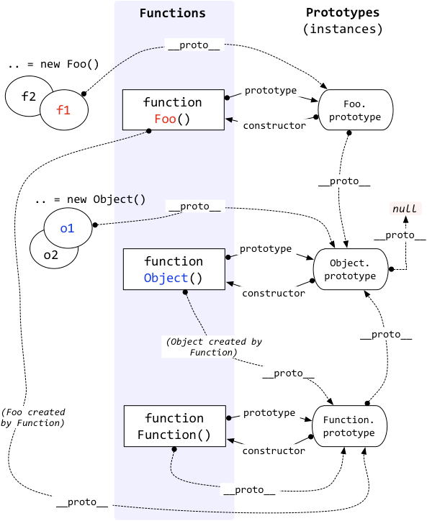
prototype, __proto__, getPrototypeOf()
Object.prototype is the base
of all other objects
Notes:
JavaScript Object Layout: http://www.mollypages.org/misc/js.mp

Slide 45
prototype, __proto__, getPrototypeOf()
13 - prototype, __proto__, getPrototypeOf

Slide 46
Simple JavaScript Inheritance
"Premature optimization is the root of all evil.“
-- Donald Knuth
Facilitates classical OOP techniques:
- constructor (through “init” method)
- base class (all the classes inherit from a base Class)
- inheritance (through “extend” method)
- method overriding (through “_super” method)
Some minuses of using this approach:
- prototype and __proto__ no working as expected
- no private members
Notes:
John Resig - http://ejohn.org/blog/simple-javascript-inheritance/
JClass is an Advanced JavaScript inheritance model providing genuine private members based on Simple JavaScript Inheritance: https://github.com/riga/jclass
jQuery Class Plugin is based off John Resig's Simple Class Inheritance library: http://v3.javascriptmvc.com/docs/jQuery.Class.html#&who=jQuery.Class
Performance tests: http://jsperf.com/backbone-vs-john-resig-class/4

Slide 47
Simple JavaScript Inheritance
14 - Simple JavaScript Inheritance.html

Slide 48

ECMAScript 6 Class Features
ECMAScript 6 is the next version of the ECMScript standard .
class ParentObjectClass extends Object {
constructor (options) {
this._val = options.value;
}
getMyString () {
return this._val;
}
}
class ChildObjectClass extends ParentObjectClass {
constructor (options) {
super(options);
}
getMyString () {
return super() + " modified";
}
}
Notes:
ECMAScript 6 Resources For The Curious JavaScripter: http://addyosmani.com/blog/ecmascript-6-resources-for-the-curious-javascripter/
ECMAScript 6 compatibility table: http://kangax.github.io/es5-compat-table/es6/
Compiler that allows you to use new and proposed language features: https://github.com/google/traceur-compiler
Addy Osmani TodoMVC based on ECMAScript 6 features: http://addyosmani.github.io/traceur-todomvc/docs/app.html

Slide 49
ECMAScript 6 Class Features
15 - ECMAScript6 Class Features.html

Slide 50
Thank you!
Cosmin Nicula
Blog: http://cosmi.nu
GitHub: https://github.com/cosminnicula
Twitter: https://twitter.com/cosminnicula

